Slide 1
Dessert session ECG basics and lead reversals
Dr. Benny J. Panakkal
Senior Resident
Dept. of Cardiology
Govt. Medical College, Kozhikode.

Slide 2
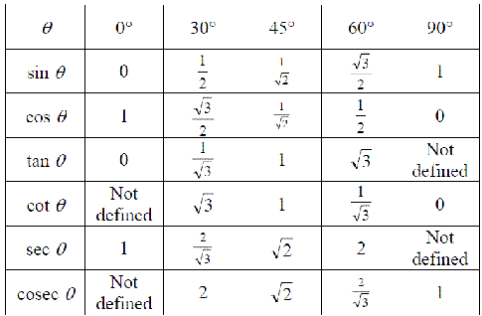

Slide 3
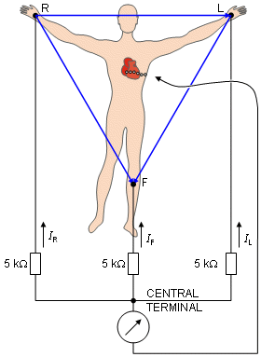
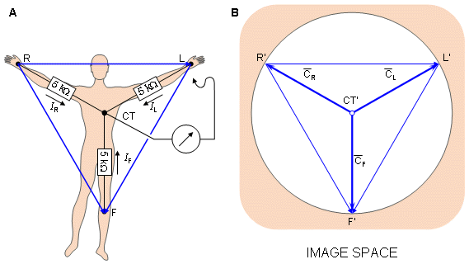
Kirchhoff’s law requires that I_{R} + I_{L} + I_{F} = 0

Slide 4
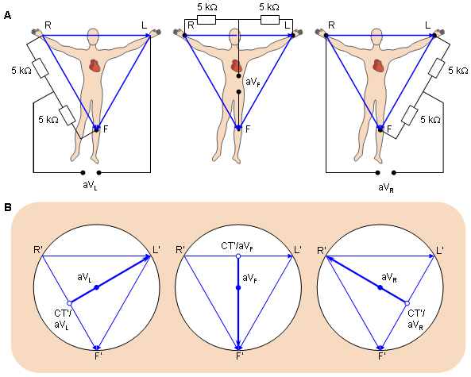
Goldberger modification for augmented limb leads
50% augmentation

Slide 5
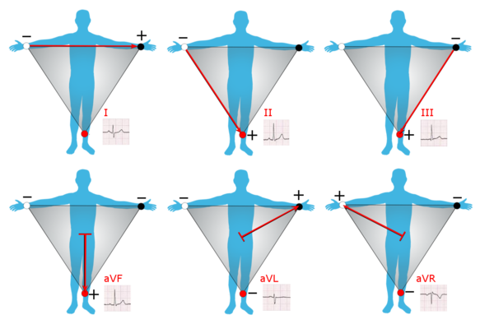

Slide 6
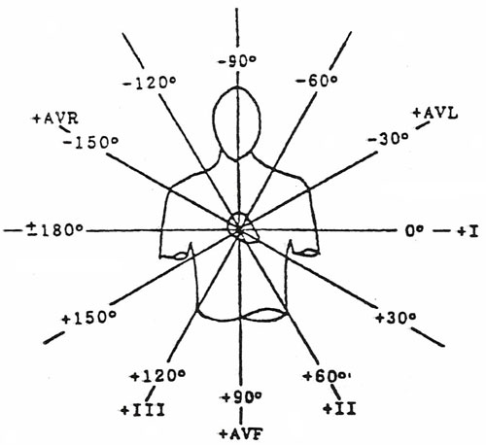

Slide 7
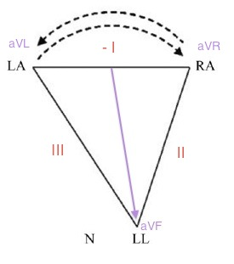
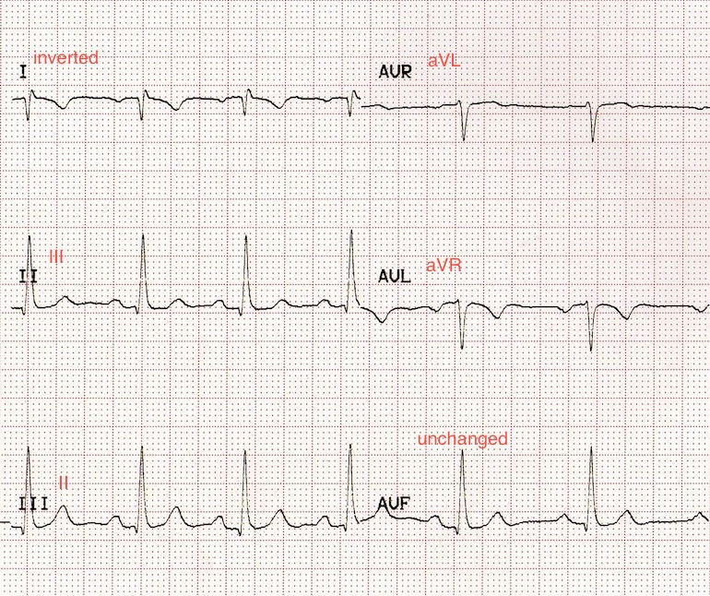
Left arm – right arm reversal

Slide 8
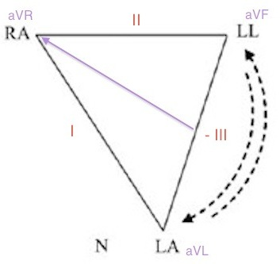
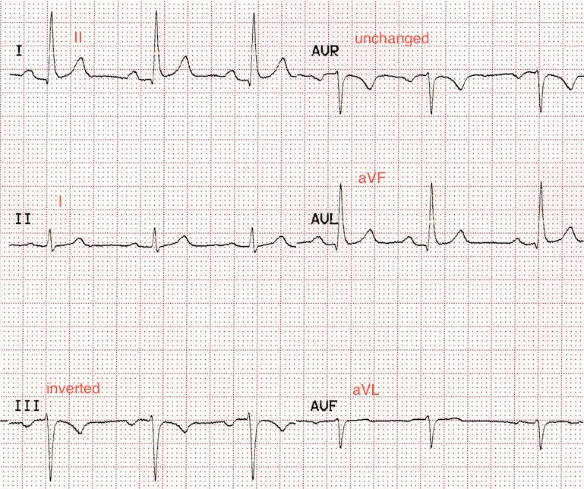
Left arm – left leg reversal

Slide 9
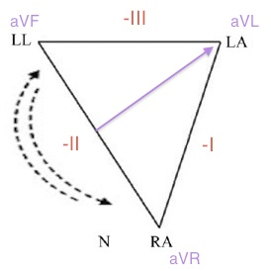
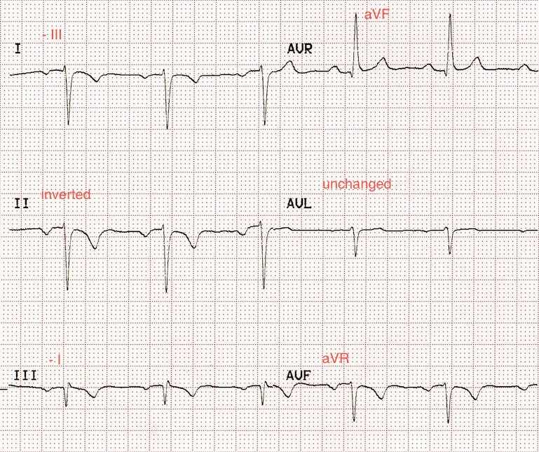
Right arm – left leg reversal

Slide 10
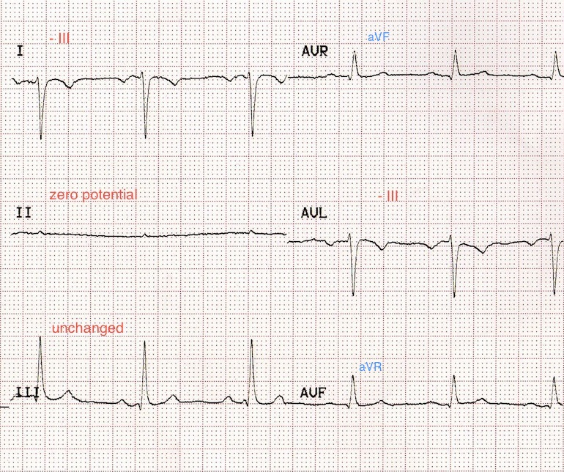
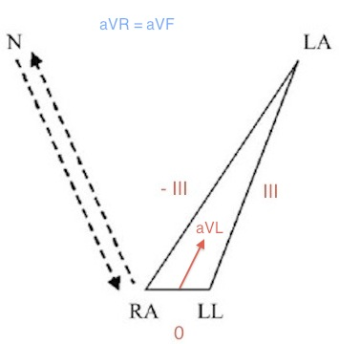
Right arm – Right leg (N) reversal

Slide 11
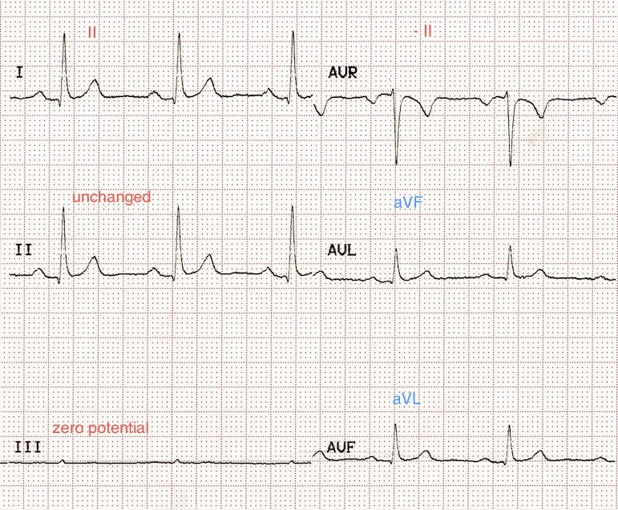
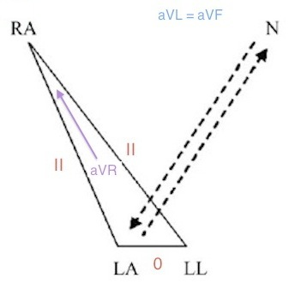
Left arm – Right leg (N) reversal

Slide 12
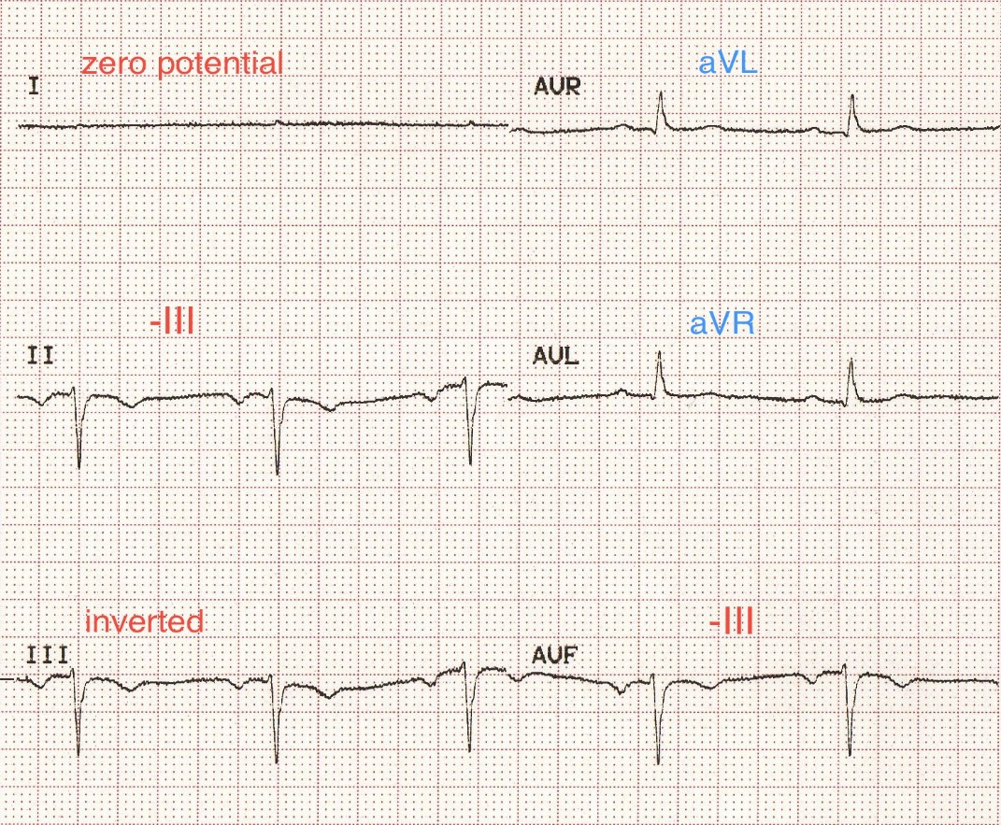
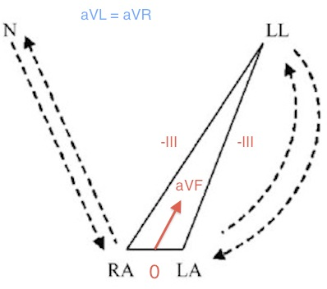
Bilateral arm-leg
reversal

Slide 13
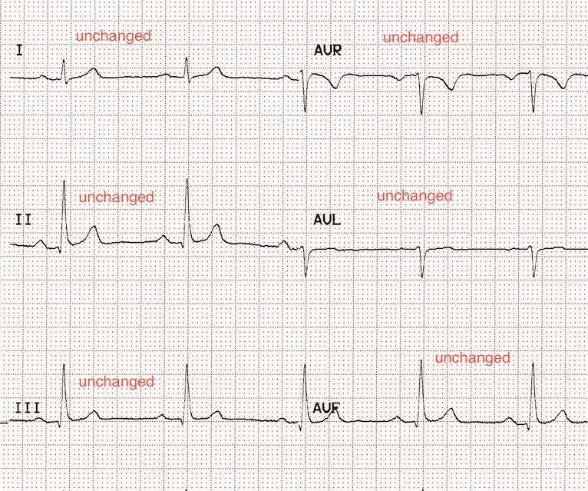
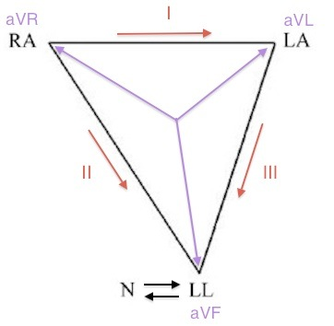
Right leg (N) – Left leg
reversal

Slide 14
The electrode on the right leg
Indifferent electrode
Ground
Neutral

Slide 15
THANK YOU

